Slide 1



Our School Offer
Braiswick Primary School
SEND Team
Identifying children with SEN
What type of SEN do we provide for?
Parent/Carer involvement
Child’s involvement
What can the children access?
Assessment and Review Process
Support for transitions
SEN Teaching
Additional support and Interventions
Inclusion & Adapting the curriculum
SEN Training
Working with external agencies
SEND Policies

Slide 2



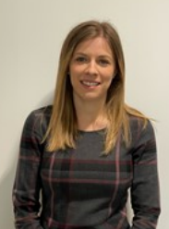

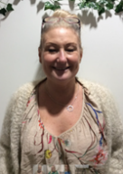

SEND Team
SENCO Mrs Mitchell | Pastoral & Induction Manager DDSL Mrs Richer | Intervention LSA Mrs Goddard | Learning Mentor Mrs Etherington

Slide 3

Identifying Children with SEND
There are several ways to identify a child’s SEND needs, including:
Baseline tests – reading and spelling
Teacher, LSA and SENCO identification through observation, marking or book sampling
Admission meetings
Parent/ Carer concerns
Tracking progress through interventions
Target Tracker analysis

Slide 4

Identifying Children with SEND
Phonics screening ​
Speech and Language screening ​
Early Years baseline ​assessments
Literacy and Maths assessments ​
Provision guidance banding descriptors (when available) ​
Pre-school assessments and liaisons between settings ​
Therapist assessments e.g. speech and language, occupational therapy ​
Existing Education Health and Care Plan (EHCP) or Medical diagnosis ​

Slide 5

What type of SEN do we provide for?
A pupil has SEN where their learning difficulty or disability calls for special educational provision, that is provision different from or additional to that normally available to pupils of the same age.
Special educational needs and provision can be considered as falling under four broad areas:
Communication and interaction
Cognition and learning
Social, emotional and mental health (SEMH)
Sensory and / or physical

Slide 6



Parent/Carer Involvement
There are a number of ways in which we communicate and involve parents and carers in the child’s education.
Formal Communication
Parent consultation meetings
Termly review meetings
One Plans / PSP’s
Team around the family meetings
Meeting with professionals
EHCP Annual reviews
Informal Communication
Discussion with class room / school staff
E-mails, Phone calls and
Weekly Newsletter

Slide 7



Childs Involvement
What arrangements are there for involving the child in their education?
Formal Involvement
One Page Profiles
Child’s voice for One Plans, PSP’s
Pupil Passport (EY)
Informal Involvement
Conversation with staff
Progress reviews
School Council
Discussion with professionals working with the child

Slide 8





What can the children access?
Quality First Teaching
Appropriate differentiation
Inclusion in activities / curriculum
Appropriate resources
Bespoke equipment
Access to after school clubs
Social skills groups
1:1 support
Support for school trips
Adult or peer support as necessary to help children access all areas of the curriculum
Bespoke curriculum under the advice of professionals
Life skills
Motor skills
Enrichment activities
School council
Lunchtime Club

Slide 9

Assessment and Review Process
Class teachers and the SEND team have a number of ways in which they review a child’s progress.
These may include: Progress reviews
Range of assessments in school
Assessments by external agencies
Pupil views
Parent/Carer views
School tracking systems
Classroom / playground observations

Slide 10


Support for Transitions
Starting in EY
Welcome meetings
School tours
Home / setting visits
Tea and Tissues
Photo books with key staff and locations in school
Stay and Play sessions
Part-time timetable to start
Transition to Braiswick
School tours
Liaison between SENCOs
Paperwork to be forwarded as soon as possible
Admissions meeting with pastoral team, you the parents and your child
Child’s One Page Profile

Slide 11
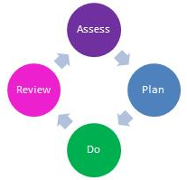

SEN Teaching
Graduated approach
Assess, Plan, Do, Review
Quality First Teaching
SEN / Pastoral Support
EHCP
Provision which is ‘additional to and different from’
Taking account of recommendations from specialist outside agencies
Relevant research based intervention programmes linked with provision guidance

Slide 12






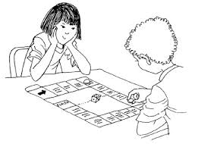

Additional support and Interventions
Forest School | Speech and Language | Play Therapy/Counselling | Talk Boost
1:1 Pastoral support | The Nest Lunch Club | Social Groups | Brain/Sensory Breaks

Slide 13










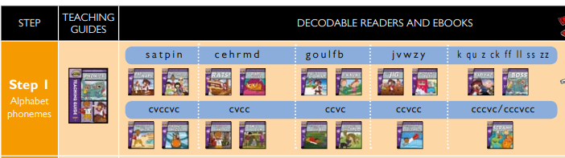




Additional support and Interventions
Lego Therapy | Zones of Regulation | Daily Readers Reading Eggs | Sensory Spaces
Nessy | Parent Workshops | Family Support | Mathletics
Art Therapy | Superflex | Time to Talk | Rapid Phonics Reading Books
Bearing Away | Dancing Bears | Apples and Pears | Plus 1 & Power of 2

Slide 14
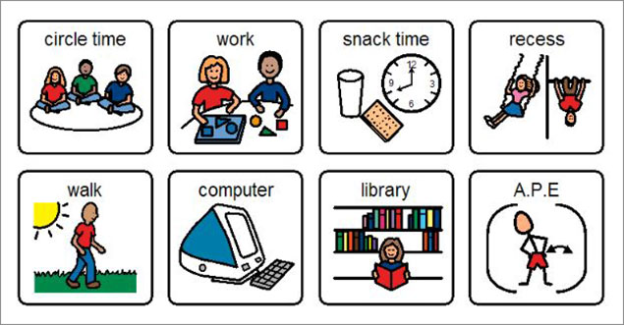

Inclusion & Adapting the Curriculum
Changes/adaptations to the physical environment
Use of assistive technology
Visuals (timetables, now and next etc.)
Advice taken from external professionals
Providing specialist resources
Playtime provision
Parent/ carer suggestions
Pupil suggestions

Slide 15


SEN Training
Our SEND and Pastoral team hold qualifications in a variety of SEND issues and national qualifications, including National SENCO Award, SALT and SEND (MA)
All school staff have received training relating to SEN
All staff receive specialist training when required and available
Our staff regularly attend a variety of training programmes organised by the local authority or relevant professionals

Slide 16

Working with External Agencies
In addition, staff can access support from the following external agencies:
Educational Psychologist
Speech and Language Therapist
Occupational Therapist
Physiotherapist advice
Emotional and Well-being Mental
Health Service (EWMHS)
Play Therapist / Counselling
Family Support
Social Care Teams and Family Solutions
SENCO update meetings and specific training
Health Visitor and School Nurse

Slide 17


SEND Policies
SEND Report
Disability Discrimination Policy
Inclusion Policy
Intimate Care Policy
Transition Policy
Managing Medicines Policy
See full list of school polices

